Slide 1
eFACTS Data Refiner
Tomas Ågren, Field test GTT

Slide 2
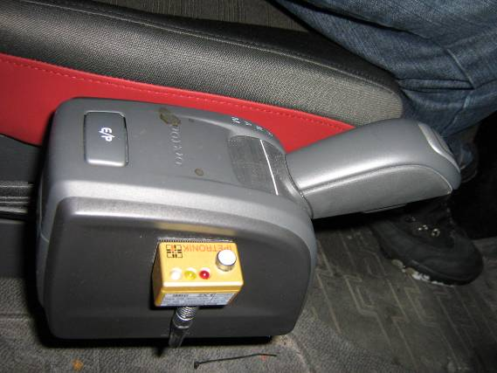
eFACTS Data Refiner
M-logger is triggered by pressing the button and records all CAN traffic, mic and also in some cases video from 15 sec before and 15 sec after pressing the button.
Typichal installation in a FH

Slide 3
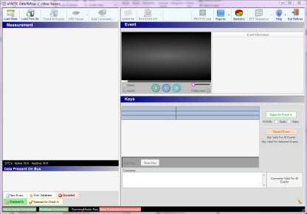
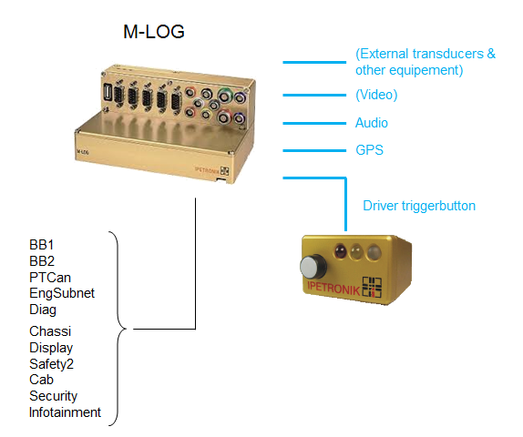
eFACTS Data Refiner

Slide 4
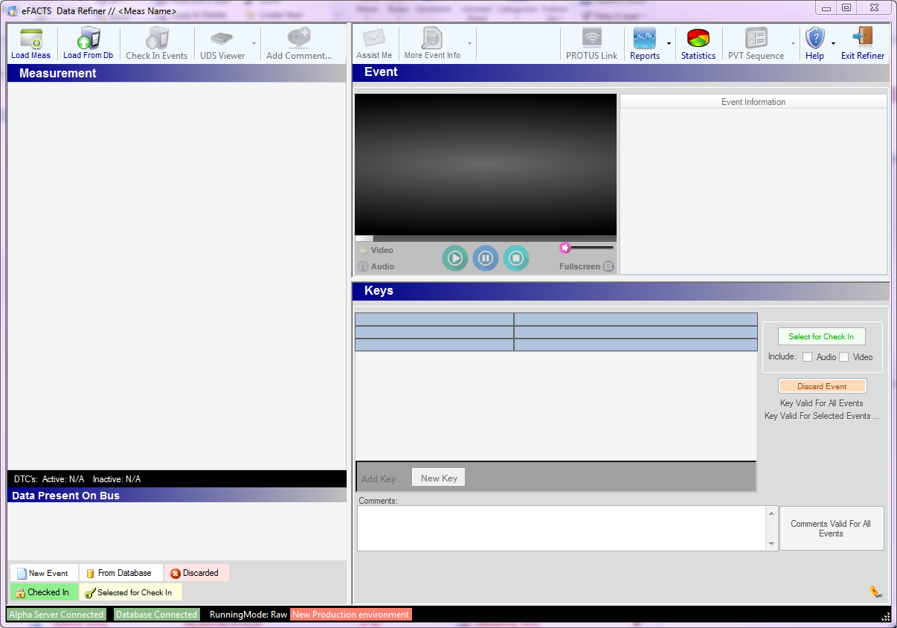
eFACTS Data Refiner

Slide 5
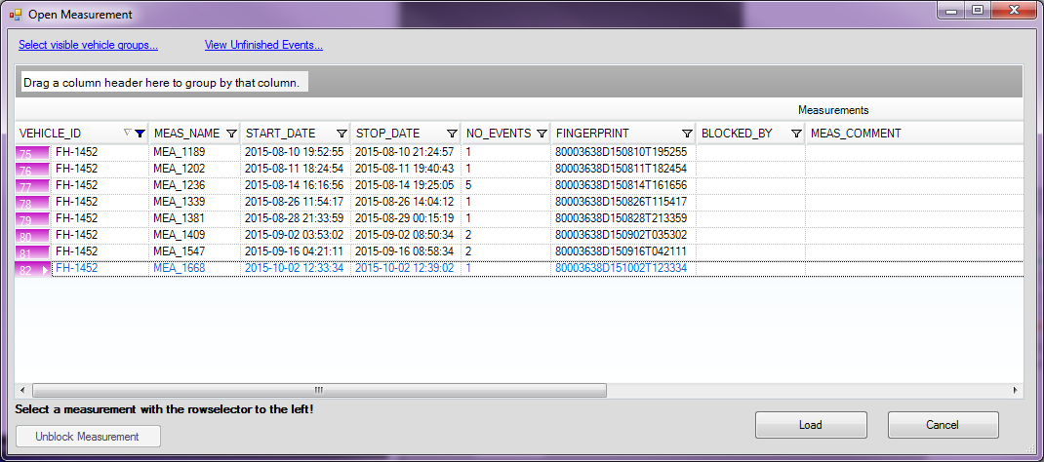
eFACTS Data Refiner

Slide 6
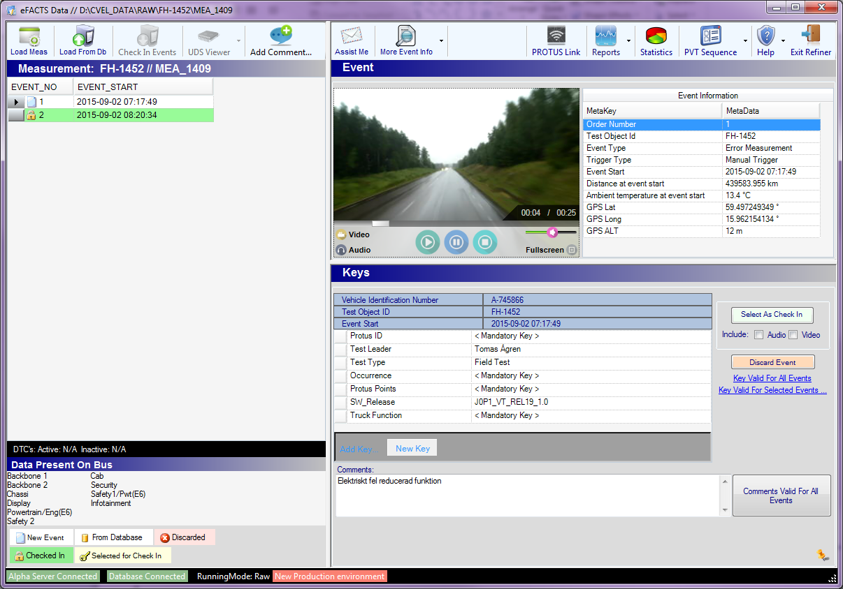
eFACTS Data Refiner

Slide 7
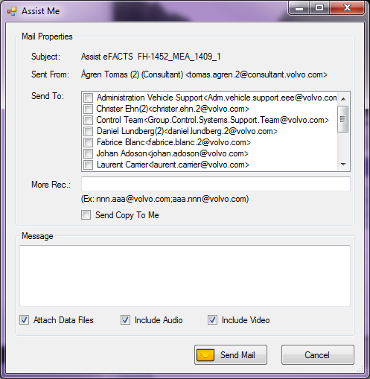
eFACTS Data Refiner

Slide 8
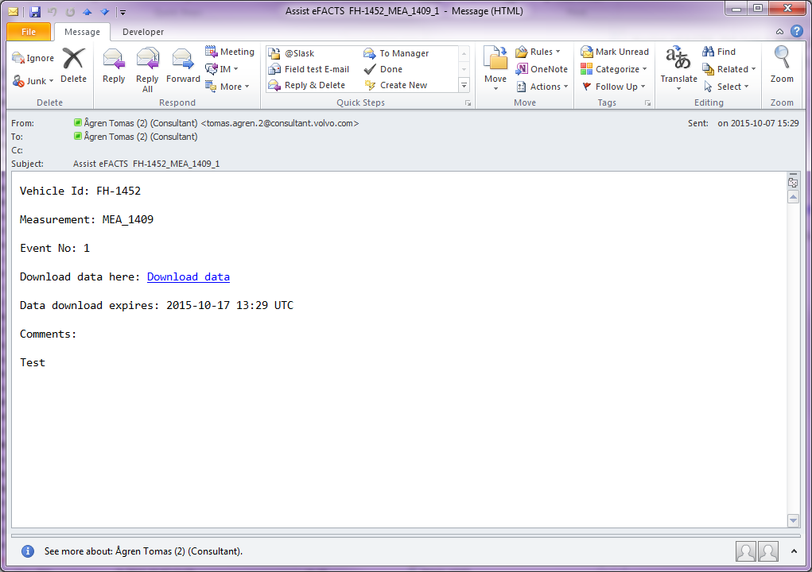
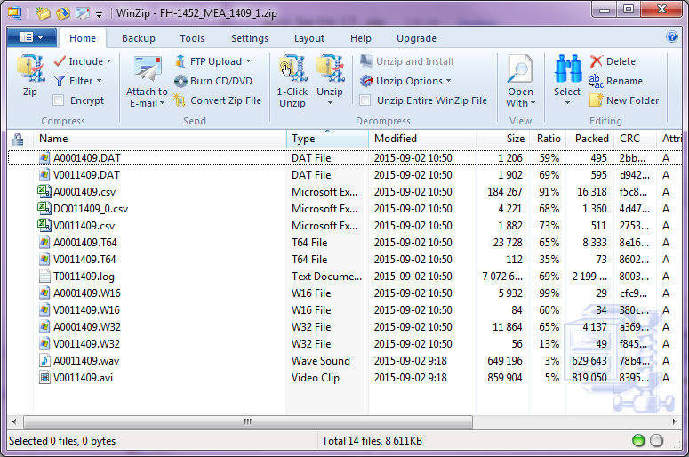
eFACTS Data Refiner

